Slide 1



analyze Northwind Database using SQL, Excel, Power BI, and Python.
Northwind Database Analysis
By:, El-Sayed El-Sawaf, Hamdy Khaled, Mahmoud Elsaeed, Adel Wasel

Slide 2
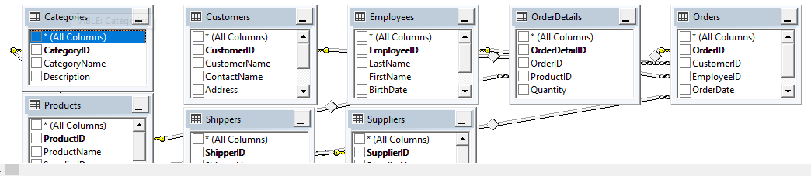
Northwind Database
Data Analyst Specialist
Overview
Northwind Database consists of 8 Tables:
Categories: Category ID, Category Name, Description
Customers: Customer ID, Customer name, Contact name, Address, City, Postal code, Country
Employees: Employee ID, Last name, First name, Birth date, Photo, Notes
Order Details: OrderDetails ID, Order ID, Product ID, Quantity
Order: Order ID, Customer ID, Employee ID, Order date, Shipper ID
Products: Product ID, Product name, Supplier ID, Category ID, Unit, Price
Shippers: Shipper ID, Shipper name, Phone
Suppliers: Supplier ID, Supplier name, Contact name, Address, City, Postal code, Country, Phone

Slide 3



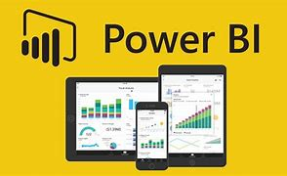

Northwind Database
Data Analyst Specialist
Our Analytical Approach
Step 1:
Data Exploration
Step 2:
Data Cleaning
Step 3:
Define the Question
Step 4:
Data Analysis
Step 5:
Visualization

Slide 4
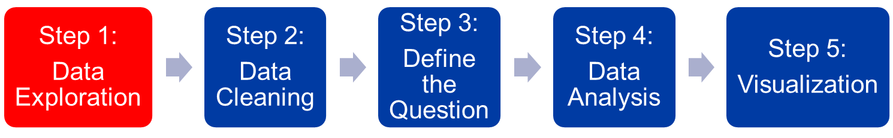
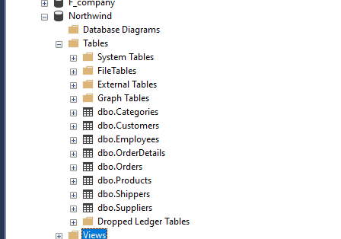

Northwind Database
Data Analyst Specialist
Our Analytical Approach

Slide 5
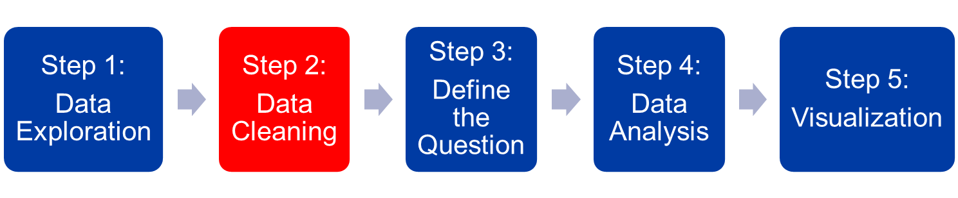
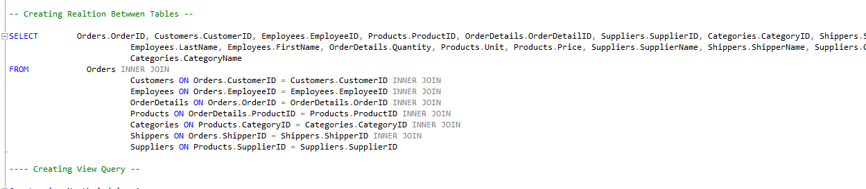
Northwind Database
Data Analyst Specialist
Our Analytical Approach

Slide 6
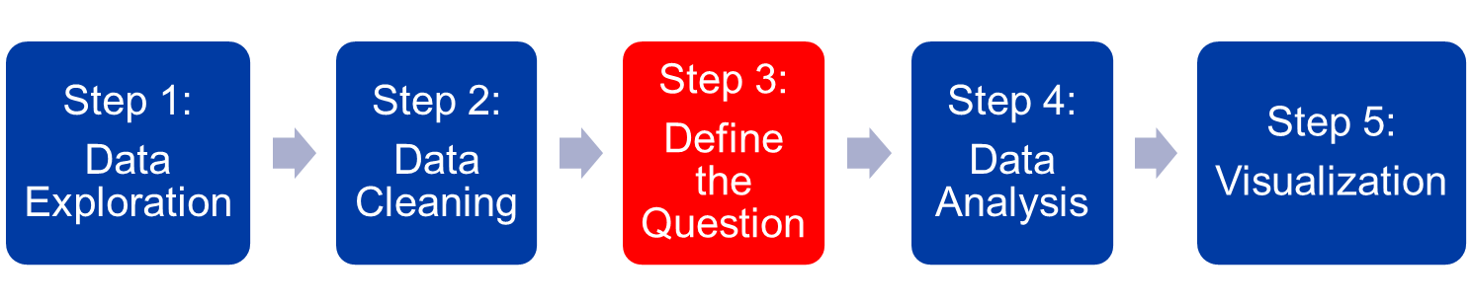
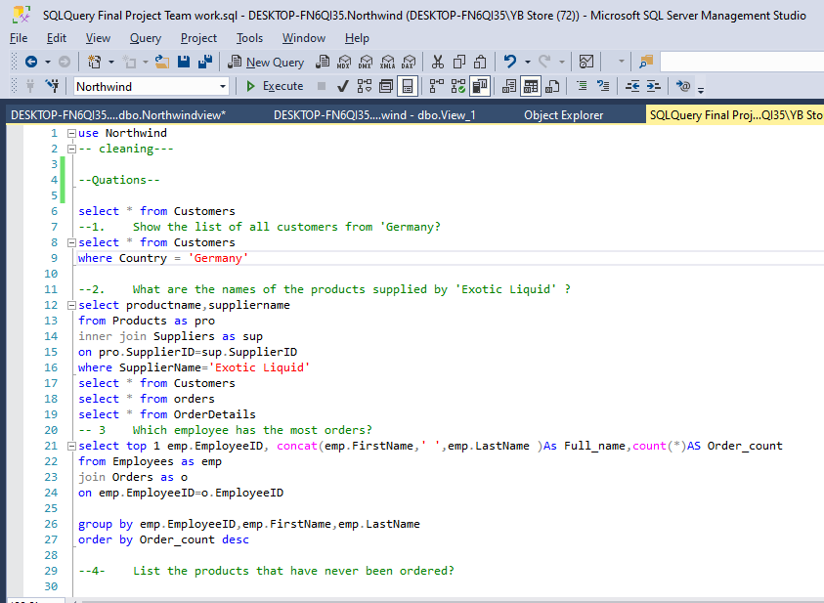
Northwind Database
Data Analyst Specialist
Our Analytical Approach

Slide 7
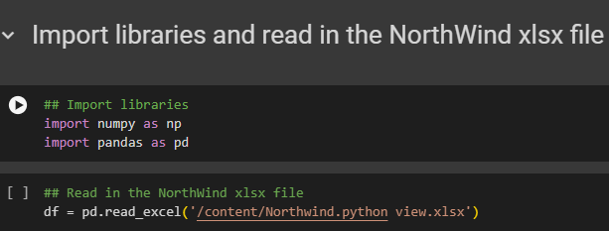
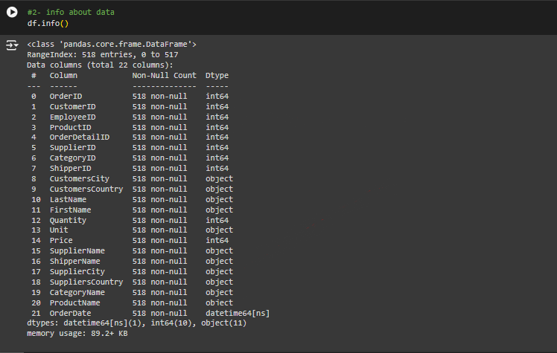
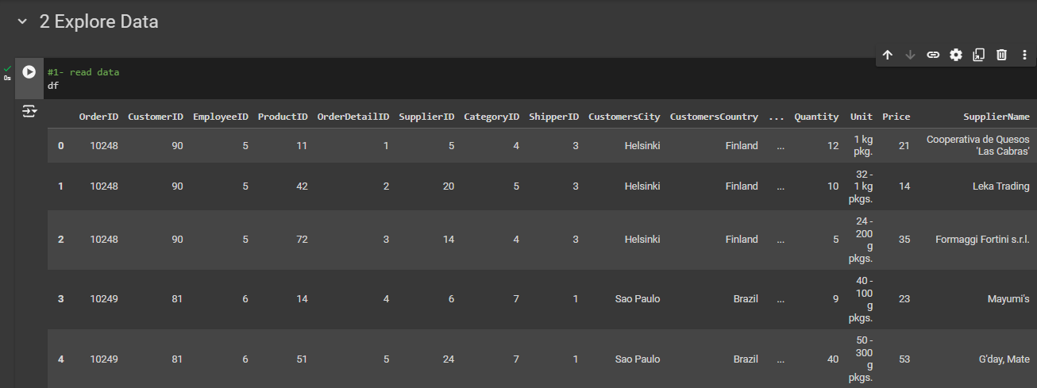
Our Analytical Approach
For Number
For Text

Slide 8


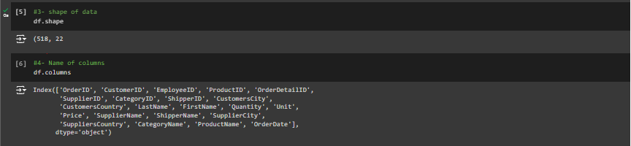
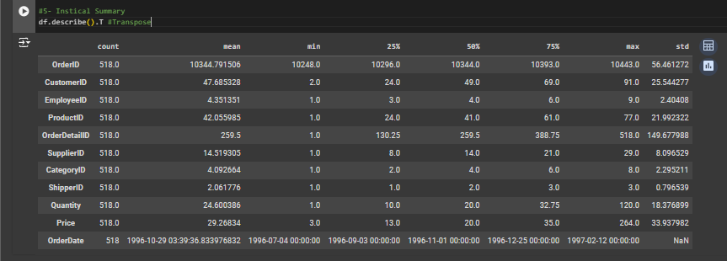
Columns
Rows

Slide 9
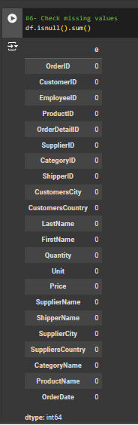
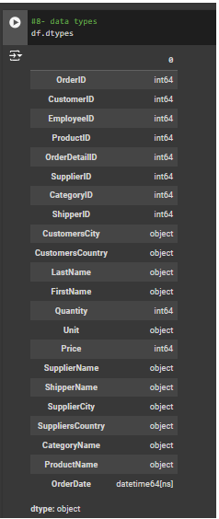
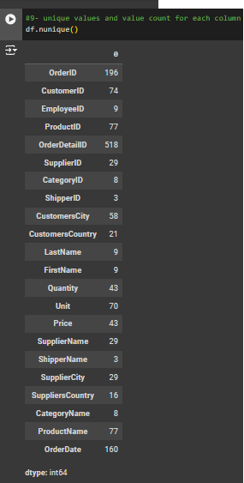
Check Missing Value
Check Data
Type
Check unique
Value
&
Count

Slide 10
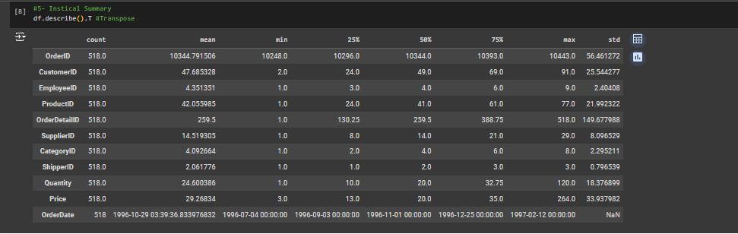
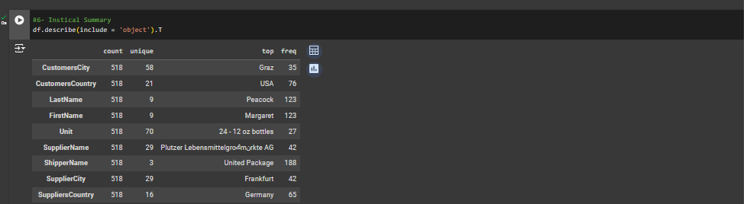
For Number
For Text

Slide 11
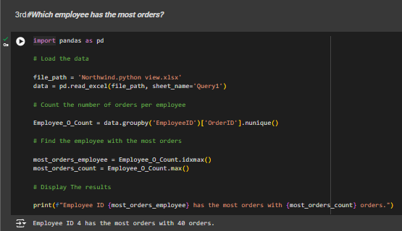
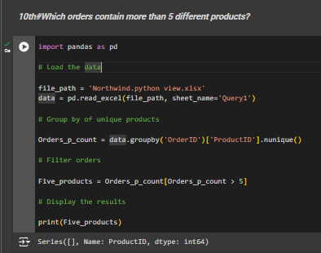
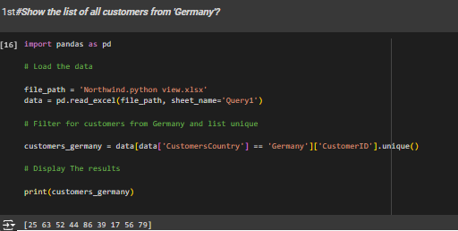
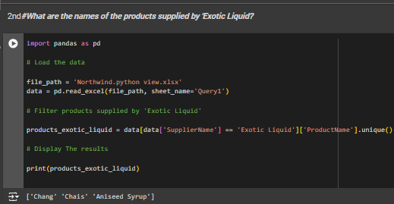
Ask Question
Which employee has the most orders?
Which orders contain more than 5 different products?
Show the list of all customers from 'Germany'?
What are the names of the products supplied by 'Exotic Liquid?

Slide 12
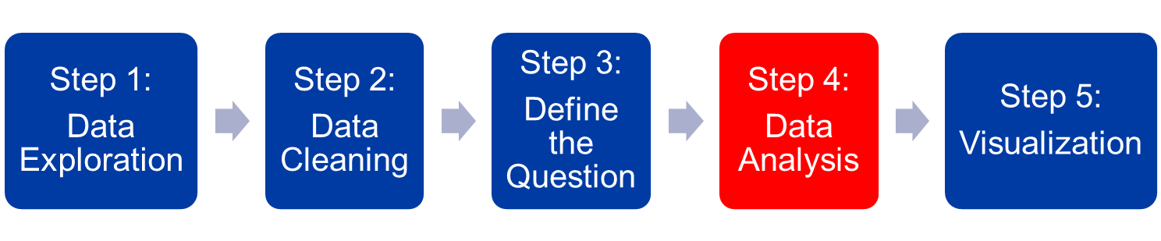
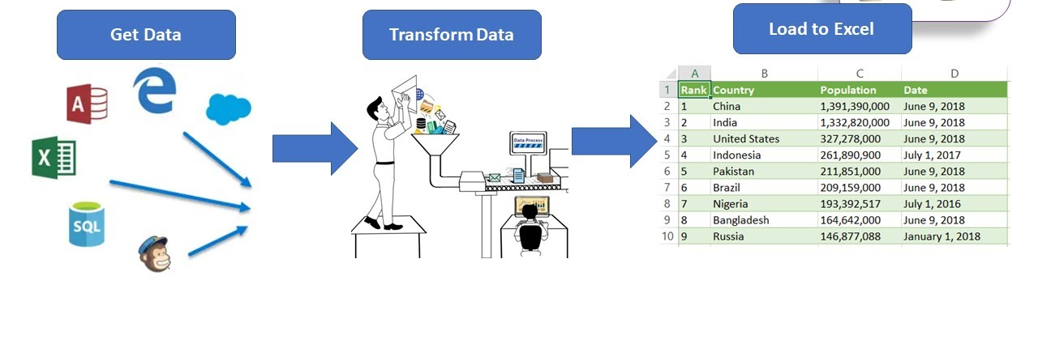
Northwind Database
Data Analyst Specialist
Our Analytical Approach

Slide 13
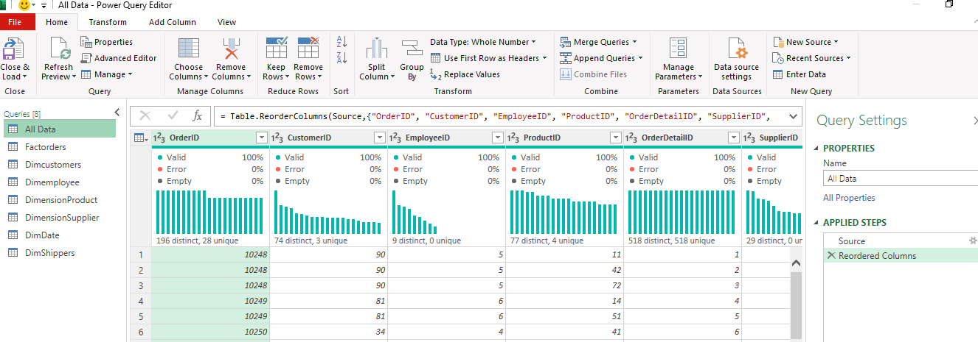
Northwind Database
Data Analyst Specialist
Our Analytical Approach

Slide 14
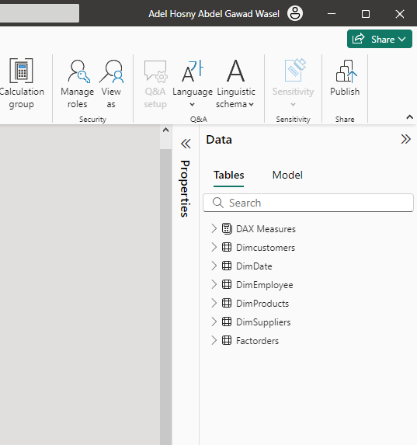
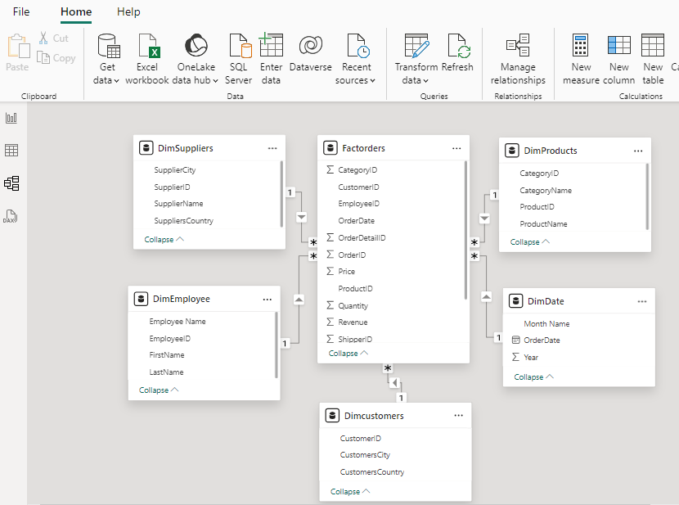
Northwind Database
Data Analyst Specialist
Our Analytical Approach

Slide 15
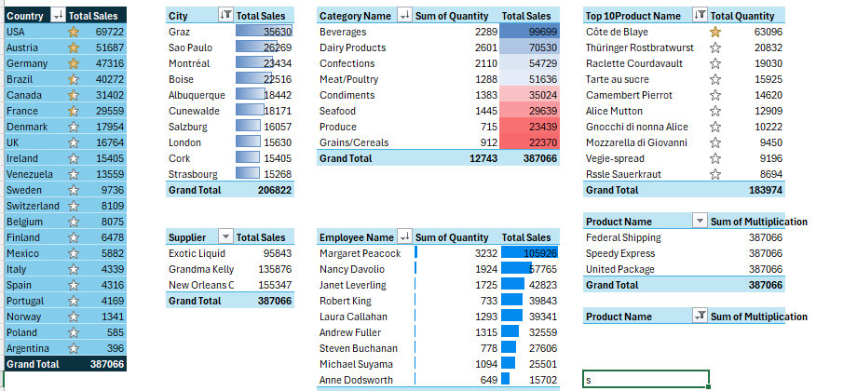
Northwind Database
Data Analyst Specialist
Our Analytical Approach

Slide 16
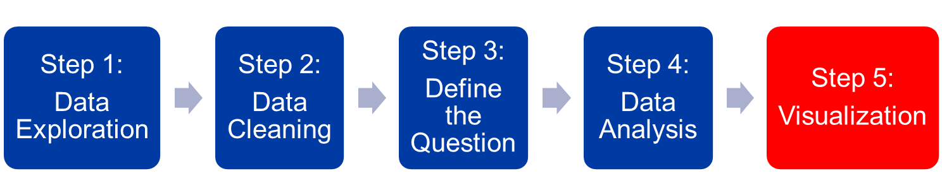
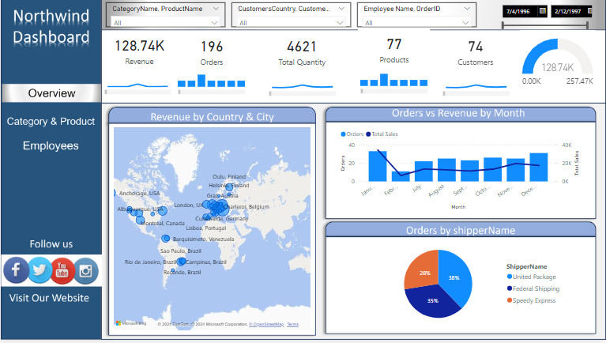
Northwind Database
Data Analyst Specialist
Our Analytical Approach

Slide 17
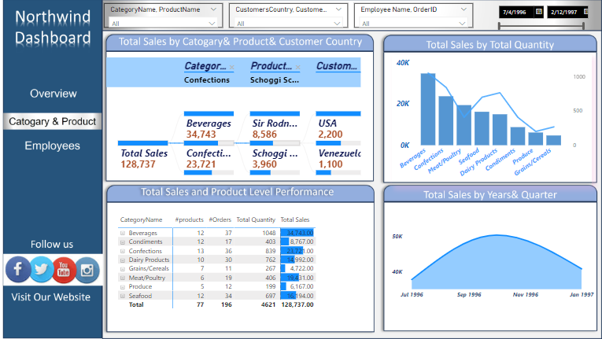
Northwind Database
Data Analyst Specialist
Our Analytical Approach

Slide 18
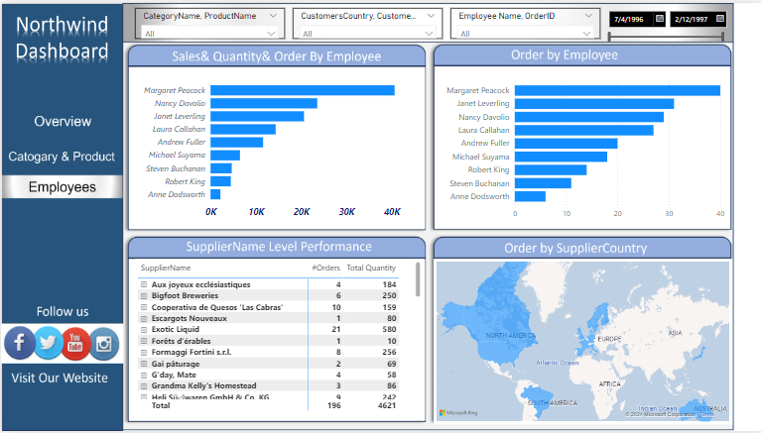
Northwind Database
Data Analyst Specialist
Our Analytical Approach

Slide 19
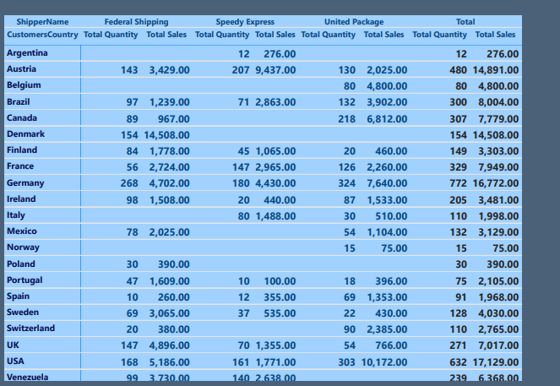
Northwind Database
Data Analyst Specialist
Our Analytical Approach

Slide 20
Northwind Database
Data Analyst Specialist
Conclusion
Key Findings:
USA is the top-selling country for all three companies.
Federal Shipping has the highest total sales and total quantity sold
Denmark has the highest total sales and quantity sold
Beverages have the highest total sales
United Package has the lowest total sales and total quantity sold.
Produce has the lowest total sales
Argentina has the lowest total sales and quantity sold among all countries.
Product-Country Relationships: Some countries might prefer specific product categories. For example, Austria might have a high demand for Beverages.
Recommendations:
Federal Shipping: Continue to leverage its market leadership position by focusing on customer satisfaction, product innovation, and efficient operations.
Target High-Performing Countries and Cities: Focus marketing efforts and product offerings in regions with high sales potential.
Leverage Employee Expertise: Assign employees to countries or regions where they have a proven track record of success

Slide 21





Our Team
El Sayed El Sawaf
Hamdy Khaled
Mahmoud El Saeed
Adel Wasel

Slide 22
Thanks

